Slide 1


Stroke Prediction by Spark
BIA-678B Group 5
Xinlian Huang
Bowen Lu
Sibo Xu

Slide 2
Agenda
Introduction
Architecture Design
Streaming Process
EDA by Spark SQL
Machine Learning
Performance Measuring
Conclusion & Improvement

Slide 3
Introduction

Slide 4
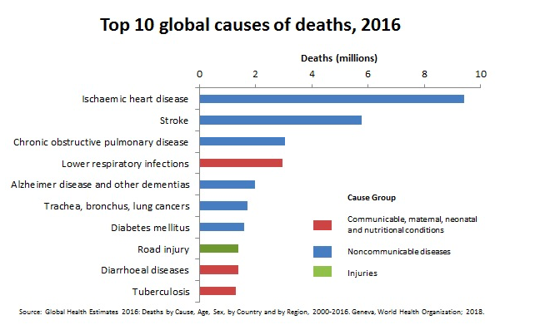
What our project is about?
About Stroke:
According to the World Health Organization, stroke is one of the world’s biggest killers.
Objective:
What we need to do is to predict the stroke probability using the given information of patients. It is a classification problem, where we will try to predict the probability of an observation belonging to a category. At the same time, we will apply Spark Streaming and Spark SQL to load/explore data.
Data Source:
Dataset was acquired from a hackathon on Analytics Vidhya for Mckinsey data set of healthcare. (Over 60,000 records)

Slide 5
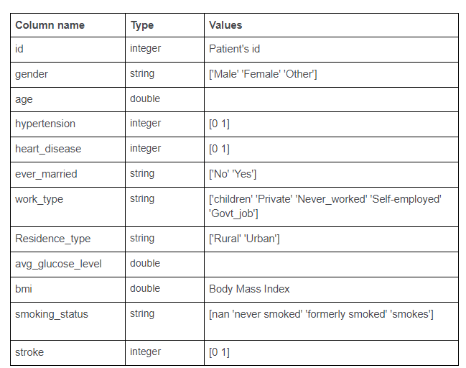
Data
Train Dataset: 43,400 rec; 12 features; 100 files, 434 rec/file.
Test Dataset: 18,600 rec; 11 features.

Slide 6
Architecture
Design

Slide 7





Architecture
FileSystem
File
Collect/Store
Process
Analyze
Data
Structured Streaming

Slide 8
Streaming
Process

Slide 9
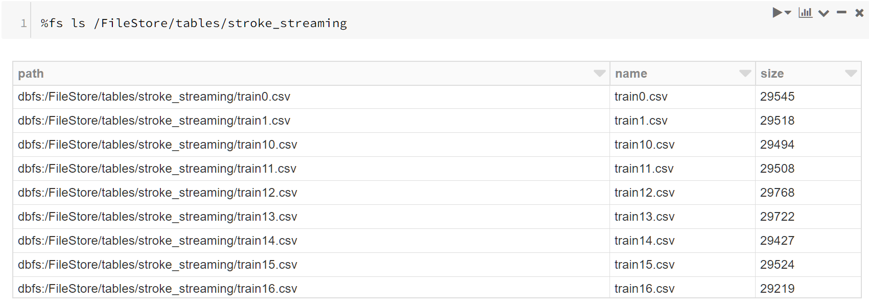
Storing Data
Databricks is using file system to store data.
Similar to the idea of Hadoop.

Slide 10
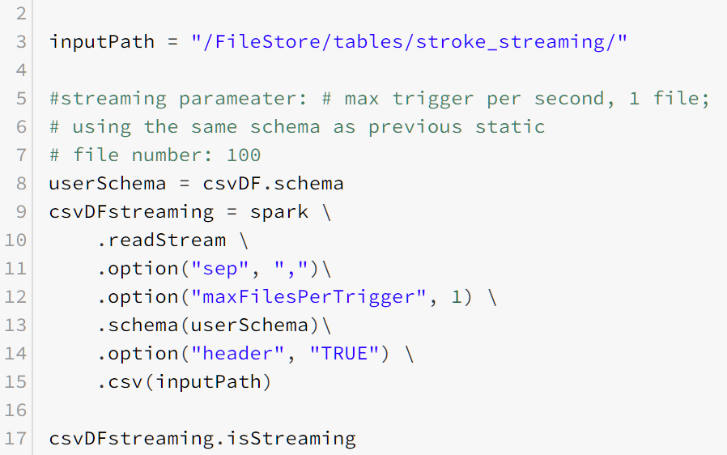
Reading Streaming Data
Use Spark Streaming to read data to create dataframe in a structured way
Read 1 file in every trigger

Slide 11
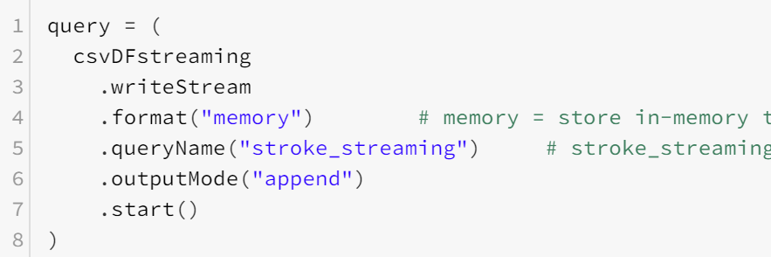
Starting Streaming
Using memory to store the table that generated
Using an appending mode to store data
Demo
Notes:
Delivering end-to-end exactly-once semantics was one of key goals behind the design of Structured Streaming. To achieve that, we have designed the Structured Streaming sources, the sinks and the execution engine to reliably track the exact progress of the processing so that it can handle any kind of failure by restarting and/or reprocessing.

Slide 12
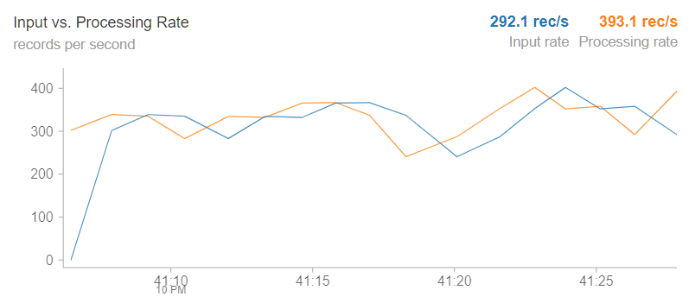
Starting Streaming

Slide 13
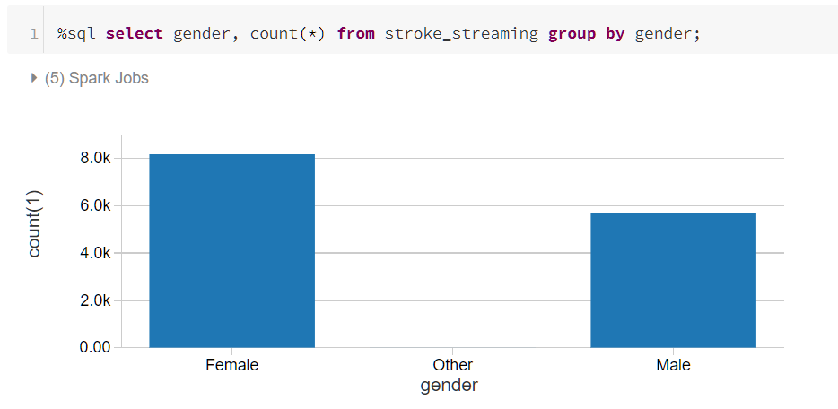
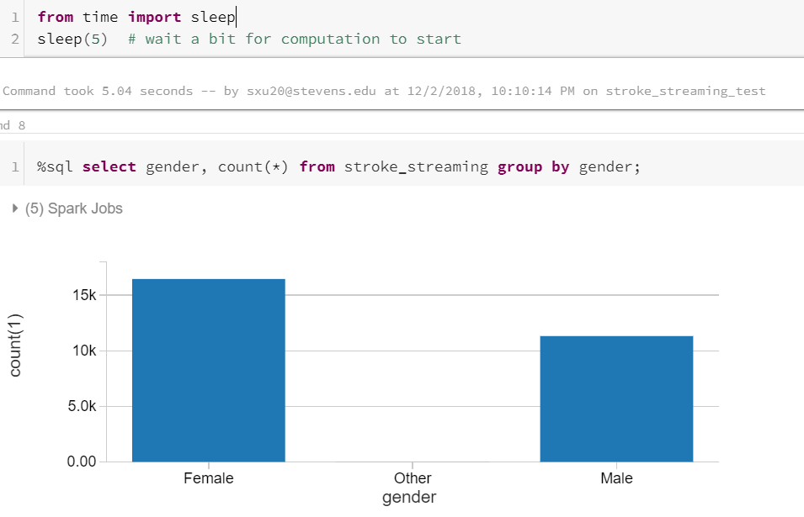
Starting Streaming

Slide 14
EDA by
Spark SQL

Slide 15
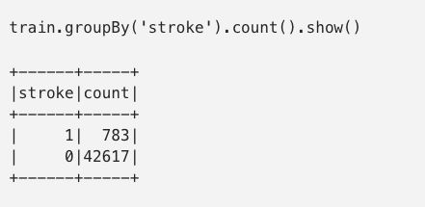
Imbalanced Distribution
Stroked records are 1.8% out of 43K training observations
Biased dataset will lead to inaccurate modeling - strategies of dealing with such dataset is described later

Slide 16
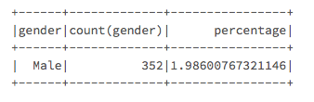
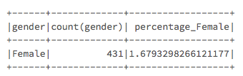
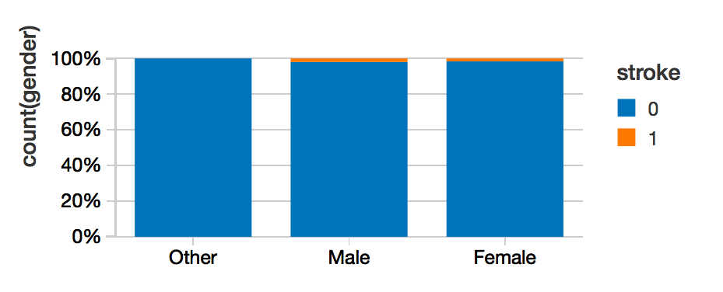
Distribution by Gender
59% Female vs. 40% Male participants in stroke research
Stroke observations take up 2% in male and 1.7% in female
Gender might not be the key factor caused stroke

Slide 17
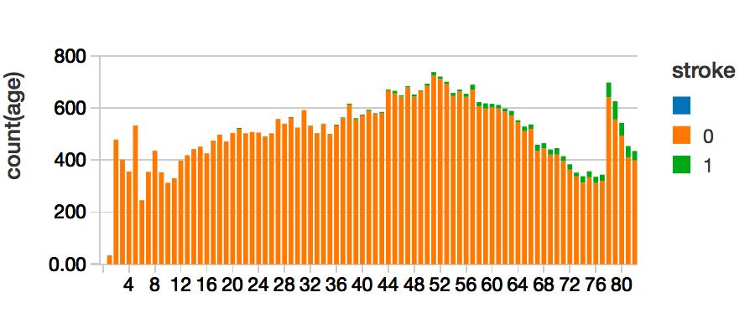

Distribution by Age
Stroked records are aggregated more among older people
Out of 783 stroked participants, 708 people age at 50+, which takes up 90%
Age can be a risk factor

Slide 18
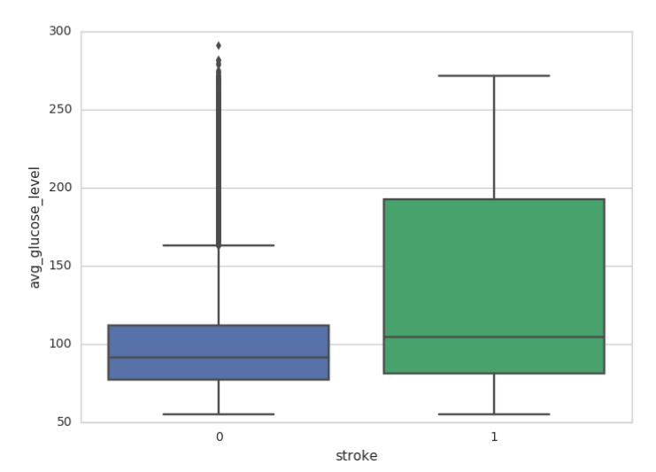
Distribution by Glucose Level
Stroked records are at a higher glucose level
Stroked records spread out

Slide 19
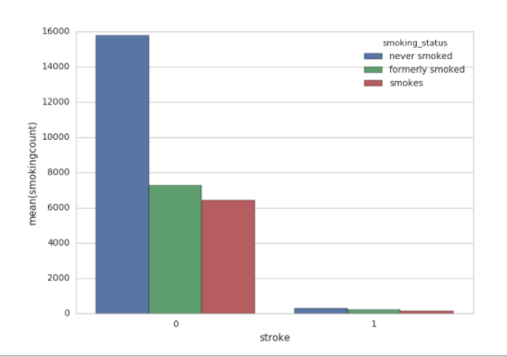
Distribution by Smoking Status
Overall there is no obvious clue indicating stroke relates to smoke status
In stroked people, there are even more people who never smoke than who smoke

Slide 20
EDA Takeaways
Overall dataset is highly imbalanced, preprocessing is needed
Age, glucose level can be key contributors
Gender, work type and smoke status don’t make too much difference

Slide 21
Machine
Learning

Slide 22
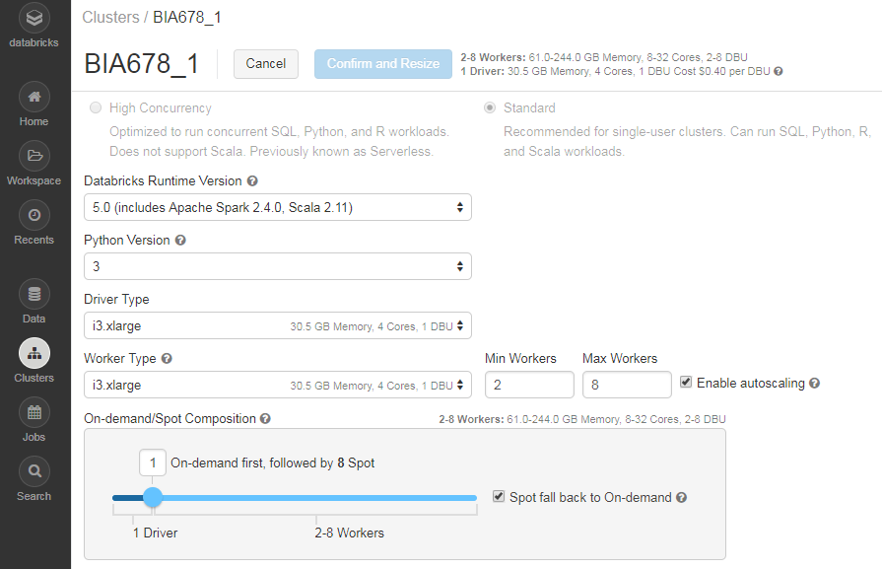
Spark Cluster
Spark Master at spark://10.219.243.48:7077

Slide 23
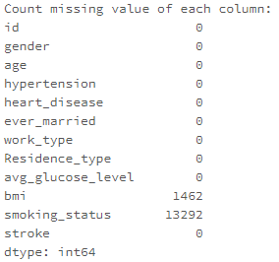
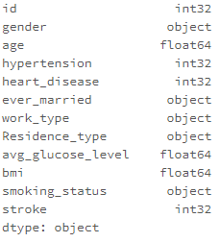
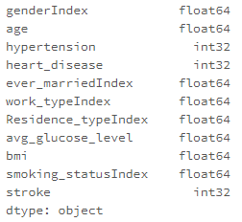
Dataset Preprocessing
Missing Value Imputation
bmi (continuous) → impute by mean
smoking_status (categorical)
→ create new category
2. Categorical Feature Encoding

Slide 24
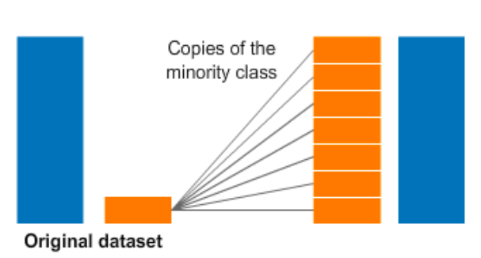
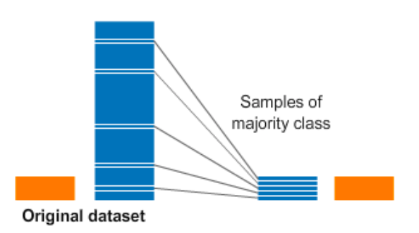


Dataset Preprocessing
3. Oversampling Imbalanced Data
Synthetic Minority Over-sampling Technique
(generate synthetic examples → mitigate overfitting)
Notes:
A subset of data is taken from the minority class as an example and then new synthetic similar instances are created. These synthetic instances are then added to the original dataset.

Slide 25
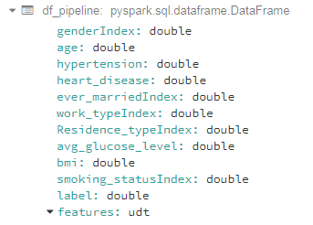

Build ML classification model
Assemble features into a single vector column
2. Build a pipeline workflow
(a sequence of stages for ML)
3. Split train & test set (0.8/0.2)
4. Implement four classification algorithms
Logistic Regression (threshold=0.5, maxIter=10)
Decision Tree (maxDepth=5, impurity="gini")
Random Forest (maxDepth=5, numTrees=20, subsamplingRate=1.0)
Gradient-Boosted Tree (maxDepth=5, maxIter=5, subsamplingRate=1.0)

Slide 26
Performance
Measuring

Slide 27
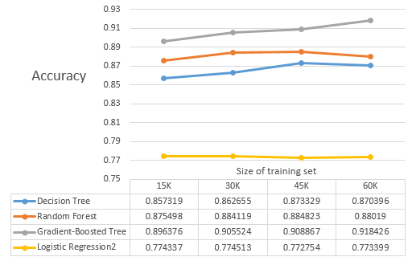
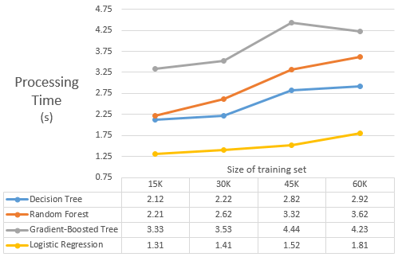
Impact of
Scale

Slide 28
Impact
of
Parallel Processor

Slide 29
Conclusion
Improvement

Slide 30
Conclusion
With scale of data increasing, the accuracy of classification model raises, while the processing time also rises.
2. Ensemble algorithms have better prediction than simple
classifier, although requiring longer time.
3. Resampling the imbalanced dataset results in significant
change in model performance.
4. Introduce the ROC curve and AUC to measure the performance and detect problems like overfitting.

Slide 31
Improvement
Check the fault-tolerance of structured streaming processing via Spark Streaming
Feed prediction models with much larger volume of data
Conduct grid search to tune the parameter in prediction models

Slide 32
Thank you!

